Slide 1
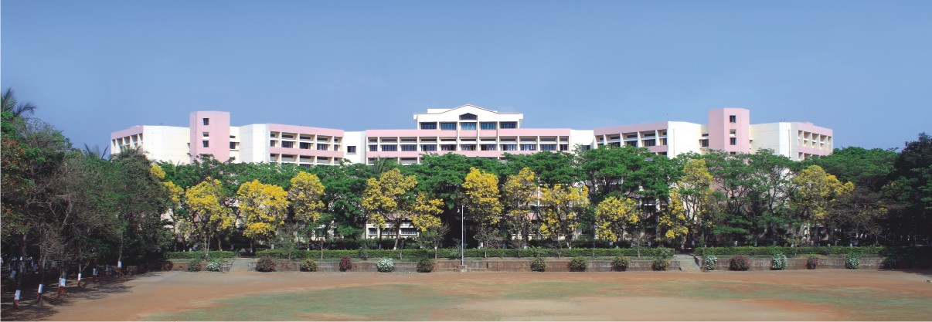

Software Engineering
Department of Computer Engineering
K. K. Wagh Institute of Engineering Education & Research, Nashik
Notes:
NOTE:
To change the image on this slide, select the picture and delete it. Then click the Pictures icon in the placeholder to insert your own image.

Slide 2
Unit 5
Project Scheduling and Risk Management

Slide 3
Contents
Project Scheduling: Basic Principles, Task set for Software Project, Task Network, Scheduling
Risk Management: Reactive versus Proactive Risk Strategies, Software Risks, Risk Identification, Risk Projection, Risk Refinement, The RMMM Plan

Slide 4
Project Scheduling
Although there are many reasons why software is delivered late, most can be traced to one or more of the following root causes:
An unrealistic deadline established by someone outside the software team and forced on managers and practitioners.
Changing customer requirements that are not reflected in schedule changes.
An honest underestimate of the amount of effort and/or the number of resources that will be required to do the job.
Predictable and/or unpredictable risks that were not considered when the project commenced.
Technical difficulties that could not have been foreseen in advance.
Human difficulties that could not have been foreseen in advance.
Miscommunication among project staff that results in delays.
A failure by project management to recognize that the project is falling behind schedule and a lack of action to correct the problem.

Slide 5
Project Scheduling
Following steps can be used in this situation –
Perform a detailed estimate using historical data from past projects. Determine the estimated effort and duration for the project.
Using an incremental process model, develop a software engineering strategy that will deliver critical functionality by the imposed deadline, but delay other functionality until later. Document the plan.
Meet with the customer and explain why the imposed deadline is unrealistic.
Offer the incremental development strategy as an alternative

Slide 6
Project Scheduling
Software project scheduling is an action that distributes estimated effort across the planned project duration by allocating the effort to specific software engineering tasks.
Scheduling for software engineering projects can be viewed from two different perspectives.
An end date for release of a computer-based system has already been established.
Effort is distributed to make best use of resources, and an end date is defined after careful analysis of the software

Slide 7
Project Scheduling: Basic Principles
A number of basic principles that guide software project scheduling are -
Compartmentalization: The project must be compartmentalized into a number of manageable activities and tasks.
Interdependency: The interdependency of each compartmentalized activity or task must be determined.
Time allocation: Each task to be scheduled must be allocated some number of work units (e.g., person-days of effort).
Effort validation: Every project has a defined number of people on the software team.
Defined responsibilities: Every task that is scheduled should be assigned to a specific team member.
Defined outcomes: Every task that is scheduled should have a defined outcome
Defined milestones: Every task or group of tasks should be associated with a project milestone
Each of these principles is applied as the project schedule evolves.

Slide 8
Defining A Task Set For The Software Project
A task set is a collection of software engineering work tasks, milestones, work products, and quality assurance filters that must be accomplished to complete a particular project.
In order to develop a project schedule, a task set must be distributed on the project time line.
The task set will vary depending upon the project type and the degree of rigor with which the software team decides to do its work.

Slide 9
Defining A Task Set For The Software Project
To develop a comprehensive taxonomy of software project types, most software organizations encounter the following projects:
Concept development projects that are initiated to explore some new business concept or application of some new technology.
New application development projects that are undertaken as a consequence of a specific customer request.
Application enhancement projects that occur when existing software undergoes major modifications to function, performance, or interfaces that are observable by the end user.
Application maintenance projects that correct, adapt, or extend existing software in ways that may not be immediately obvious to the end user.
Reengineering projects that are undertaken with the intent of rebuilding an existing system in whole or in part.

Slide 10
A Task Set Example
Concept development projects are approached by applying the following actions:
1.1 Concept scoping determines the overall scope of the project.
1.2 Preliminary concept planning establishes the organization’s ability to undertake the work implied by the project scope.
1.3 Technology risk assessment evaluates the risk associated with the technology to be implemented as part of the project scope.
1.4 Proof of concept demonstrates the viability of a new technology in the software context.
1.5 Concept implementation implements the concept representation in a manner that can be reviewed by a customer and is used for “marketing” purposes when a concept must be sold to other customers or management.
1.6 Customer reaction to the concept solicits feedback on a new technology concept and targets specific customer applications.

Slide 11
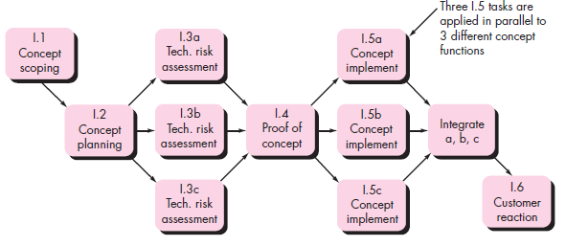
Defining A Task Network

Slide 12
Scheduling
Generalized project scheduling tools and techniques can be applied with little modification for software projects.
Program evaluation and review technique (PERT) and the Critical Path Method (CPM) are two project scheduling methods that can be applied to software development.
Both PERT and CPM provide quantitative tools that allows you to –
determine the critical path—the chain of tasks that determines the duration of the project,
establish “most likely” time estimates for individual tasks by applying statistical models, and
calculate “boundary times” that define a time “window” for a particular task.

Slide 13
Time-Line Charts
A time-line chart, also called a Gantt chart.
A time-line chart can be developed for the entire project.
When creating a software project schedule, begin it with a set of tasks (the work breakdown structure).
Effort, duration, and start date are then input for each task.

Slide 14
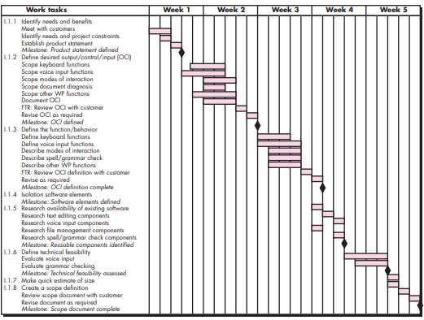
Time-Line Chart

Slide 15
A. Risk Management
Risk analysis and management are actions that help a software team to understand and manage uncertainty.
When you consider risk in the context of software engineering, there are some factors –
what risks might cause the software project to go wrong?
how will changes in customer requirements, development technologies, target environments, and all other entities connected to the project affect timeliness and overall success?
what methods and tools should you use?
how many people should be involved, how much emphasis on quality is “enough”?

Slide 16
A1. Reactive Versus Proactive Risk Strategies
Reactive risk management tries to reduce the damage of potential threats and speed an organization’s recovery from them, but assumes that those threats will happen eventually.
The reactive risk management kicks into action once an incident happens, or problems are identified after the audit.
Proactive risk management identifies threats and aims to prevent those events from ever happening in the first place.
Proactive risk management seeks to identify all relevant risks earlier, before an incident occurs.

Slide 17
A2. Software Risks
There is general agreement that risk always involves two characteristics:
uncertainty—the risk may or may not happen (there are no 100 percent probable risks)
loss—if the risk becomes a reality, unwanted consequences or losses will occur
When risks are analyzed, it is important to quantify the level of uncertainty and the degree of loss associated with each risk

Slide 18
Categories of Risks
Project risks : Project risks threaten the project plan.
If project risks become real, it is likely that the project schedule will slip and that costs will increase.
Project risks identify potential budgetary, schedule, personnel, resource, stakeholder, and requirements problems and their impact on a software project.
Project complexity, size, and the degree of structural uncertainty were also defined as project risk factors

Slide 19
Categories of Risks
Technical risks threaten the quality and timeliness of the software to be produced.
If a technical risk becomes a reality, implementation may become difficult or impossible.
Technical risks identify potential design, implementation, interface, verification, and maintenance problems.
In addition, specification ambiguity, technical uncertainty, technical obsolescence, and “leading-edge” technology are also risk factors.

Slide 20
Categories of Risks
Business risks threaten the viability of the software to be built. Candidates for the top five business risks are
building an excellent product or system that no one really wants (market risk)
building a product that no longer fits into the overall business strategy for the company (strategic risk)
building a product that the sales force doesn’t understand how to sell (sales risk)
losing the support of senior management due to a change in focus or a change in people (management risk)
losing budgetary or personnel commitment (budget risks).

Slide 21
Categories of Risks
Known risks are those that can be uncovered after careful evaluation of the project plan.
Predictable risks are extrapolated from past project experience
Unpredictable risks are the joker in the deck. They can and do occur, but they are extremely difficult to identify in advance.

Slide 22
A3. Risk Identification
Risk identification is a systematic attempt to specify threats to the project plan (estimates, schedule, resource loading, etc.).
There are two distinct types of risks for each of the categories-
Generic risks are a potential threat to every software project..
Product-specific risks can be identified only by those with a clear understanding of the technology, the people, and the environment that is specific to the software that is to be built.

Slide 23
A3. Risk Identification
One method for identifying risks is to create a risk item checklist. The checklist can be used for risk identification and focuses on some subset of known and predictable risks in the following generic subcategories:
Product size—risks associated with the overall size of the software to be built or modified. •
Business impact—risks associated with constraints imposed by management or the marketplace.
Stakeholder characteristics—risks associated with the sophistication of the stakeholders and the developer’s ability to communicate with stakeholders in a timely manner.

Slide 24
A3. Risk Identification
Process definition—risks associated with the degree to which the software process has been defined and is followed by the development organization.
Development environment—risks associated with the availability and quality of the tools to be used to build the product.
Technology to be built—risks associated with the complexity of the system to be built and the “newness” of the technology that is packaged by the system.
Staff size and experience—risks associated with the overall technical and project experience of the software engineers who will do the work.

Slide 25
A4. Risk Projection
Risk projection, also called risk estimation attempts to rate each risk in two ways-
the likelihood or probability that the risk is real and
the consequences of the problems associated with the risk, should it occur.
Four Risk Projection steps :
Establish a scale that reflects the perceived likelihood of a risk.
Delineate the consequences of the risk.
Estimate the impact of the risk on the project and the product.
Assess the overall accuracy of the risk projection so that there will be no misunderstandings.

Slide 26
A4. Risk Refinement
It may be possible to refine the risk into a set of more detailed risks, each somewhat easier to mitigate, monitor, and manage.
One way to do this is to represent the risk in condition-transition-consequence (CTC) format.

Slide 27
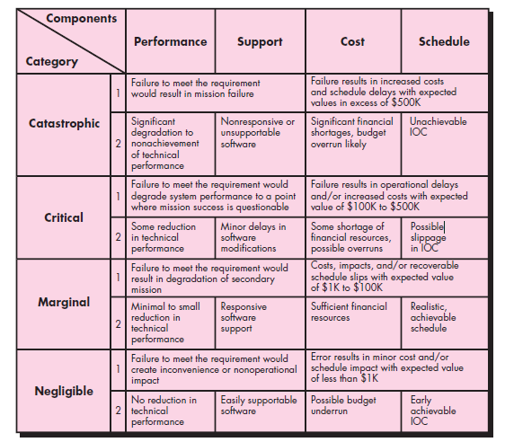
Fig : Impact Assessment

Slide 28
A5. Risk Mitigation, Monitoring, And Management (RMMM)
Risk Mitigation :
Steps for mitigating the risks:
Meet with current staff to determine causes for turnover (e.g., poor working conditions, low pay, competitive job market).
Mitigate those causes that are under your control before the project starts.
Once the project commences, assume turnover will occur and develop techniques to ensure continuity when people leave.
Organize project teams so that information about each development activity is widely dispersed.

Slide 29
A5. Risk Mitigation, Monitoring, And Management (RMMM)
Risk Monitoring :-
Primary objectives are as follows :
To check if predicted risks occur or not.
To ensure proper application of risk aversion steps defined for risk.
To collect data for future risk analysis.
To allocate what problems are caused by which risks throughout the project.

Slide 30
A5. Risk Mitigation, Monitoring, And Management (RMMM)
Risk Management and planning :
In this we assume that mitigation efforts have failed and that the risk has become a reality.

Slide 31
A5. Risk Mitigation, Monitoring, And Management (RMMM)
Software safety and hazard analysis
Software quality assurance activities focus on the identification and assessment of potential hazards that may affect software negatively and cause an entire system to fail.

Slide 32
A 8. The RMMM Plan
A risk management strategy can be included in the software project plan, or the risk management steps can be organized into a separate risk mitigation, monitoring, and management plan (RMMM).
The RMMM plan documents, all work performed as part of risk analysis and is used by the project manager as part of the overall project plan.
Once RMMM has been documented and the project has begun, risk mitigation and monitoring steps commence.
Risk mitigation is a problem avoidance activity.
Risk monitoring is a project tracking activity

Slide 33
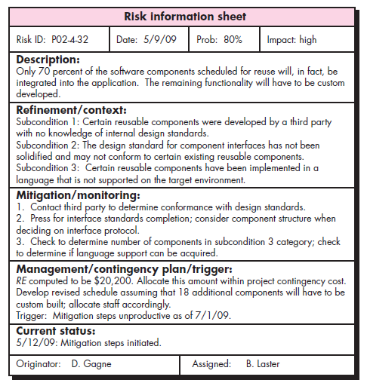
Risks Information Sheet

Slide 34
Example of RMMM
Risk Mitigation:
Meet the current staff to determine causes for turnover (e.g., poor working conditions, low pay, competitive job market).
Mitigate those causes that are under our control before the project starts.
Once the project commences, assume turnover will occur and develop techniques to ensure continuity when people leave.
Organize project teams so that information about each development activity is widely dispersed.
Define documentation standards and establish mechanisms to ensure that documents are developed in a timely manner.
Assign a backup staff member for every critical technologist.

Slide 35
Risk Monitoring:
General attitude of team members based on project pressures.
Interpersonal relationships among team members.
Potential problems with compensation and benefits.
The availability of jobs within the company and outside it.

Slide 36
Risk Management:
Risk management and contingency planning assumes that mitigation efforts have failed and that the risk has become a reality.

Slide 37
Drawbacks of RMMM:
It incurs additional project costs.
It takes additional time.
For larger projects, implementing an RMMM may itself turn out to be another tedious project.
RMMM does not guarantee a risk-free project, infact, risks may also come up after the project is delivered.

Slide 38

Thank You !!

